Slide 1

Team Instinct
Showcase
2022-06-25

Slide 2
AGENDA
Data Model
Travelers
Forecasting and Retail Agents
Billboard Pitch
Seasonality

Slide 3
DATA MODEL
Initial state of the dataset was a collection of *.csv files (some sharded) with many string fields (especially entity identifiers).
Deterministic Ordinal Serialization encodes string identifier fields. Reduced storage complexity by a lossless compression ratio of ~10:4
Engineered purpose designed data loaders to further reduce the memory complexity by a lossless compression ratio of ~10:2.3

Slide 4
DATA MODEL
Need for a distributed cluster to perform some of our intended EDA still persisted
Provisioned a Star Schema based data warehouse on Google BigQuery
Provided ease of on-the-fly extendibility to the data warehouse
The denormalized form allowed us to write small rough-and-ready queries for EDA
Allowed us to offload the analytics computation to the cloud

Slide 5
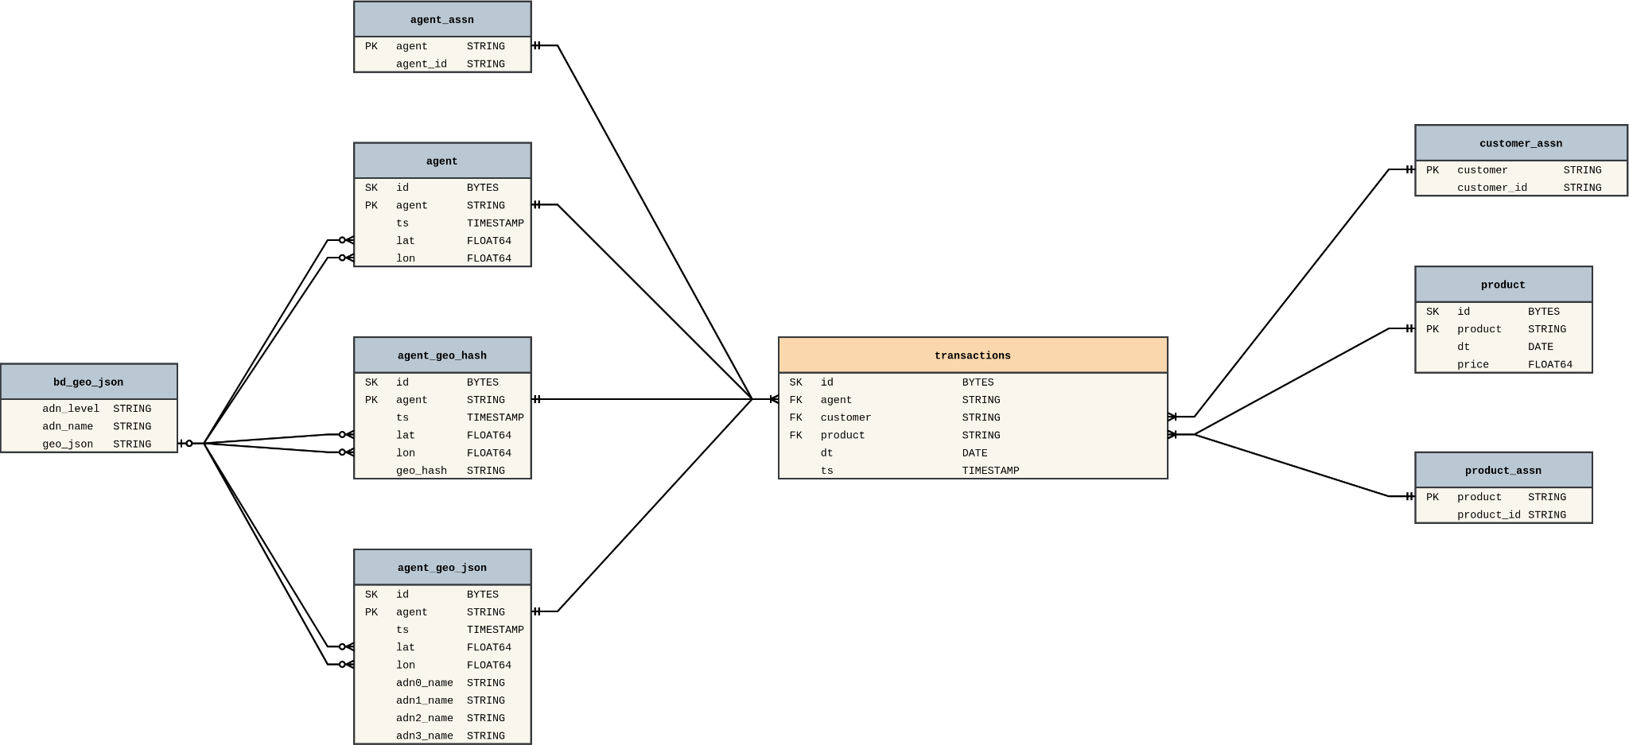
DATA MODEL

Slide 6
THE TRAVELERS
Our definition of a ‘Traveler’ is based on 3 key metrics and 1 supporting metric:
- Average Distance traveled per transaction
- Unique Agents Transacted
- Number of transactions
- Agent Uniqueness
Only customers who were in the 95th percentile for the key metrics were considered, which accounted for around 2400 people.

Slide 7
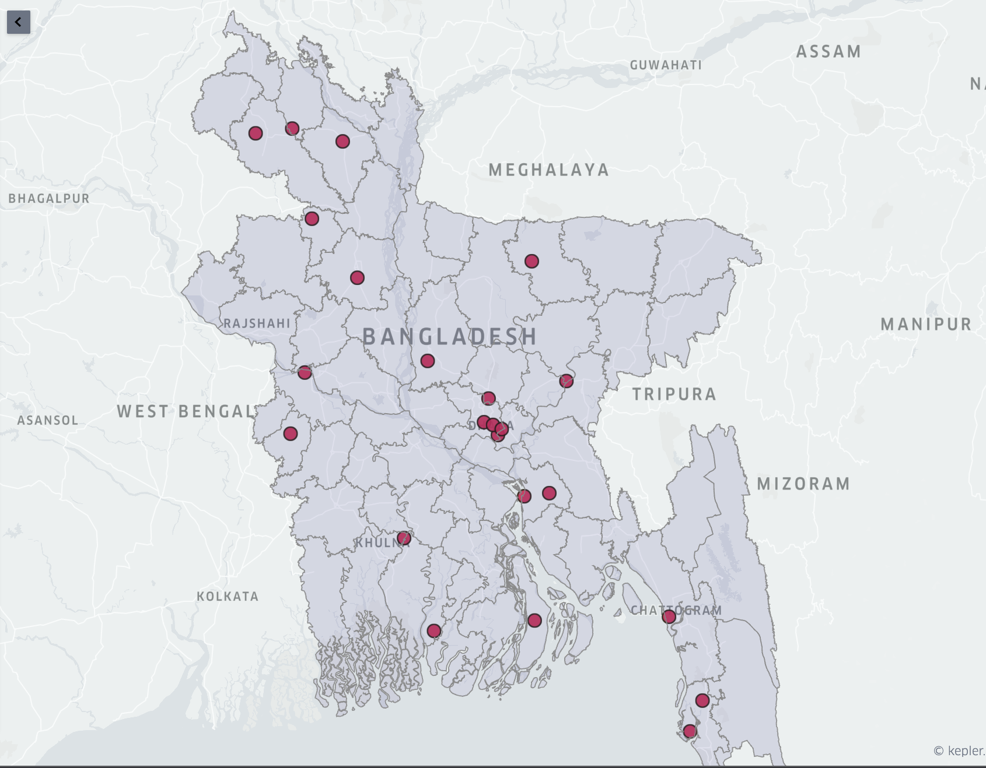

Slide 8
THE TRAVELERS
Retails serving highest number of top travelers tend to be along major highways near Dhaka and approaching Chattogram. This indicates that many travelers transact while on break during transit.
New product for travelers.
- Bundle voice and data package for short duration
- Will be tailored to make the offer lucrative to travelers
- It can only be availed via chosen retailers

Slide 9
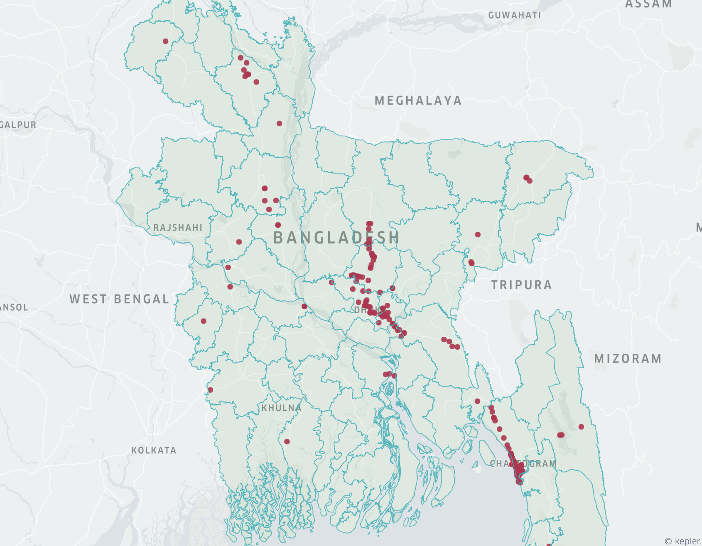

Slide 10
AGENT
Amongst top selling 100 retail, 8 of the retails have no other retail point within 500 meters radius.
Recommendation for these retails are:
These retails deal with a lot of customers, hence, good medium to market new/other products/services.
New retailers around these retails can be introduced.

Slide 11
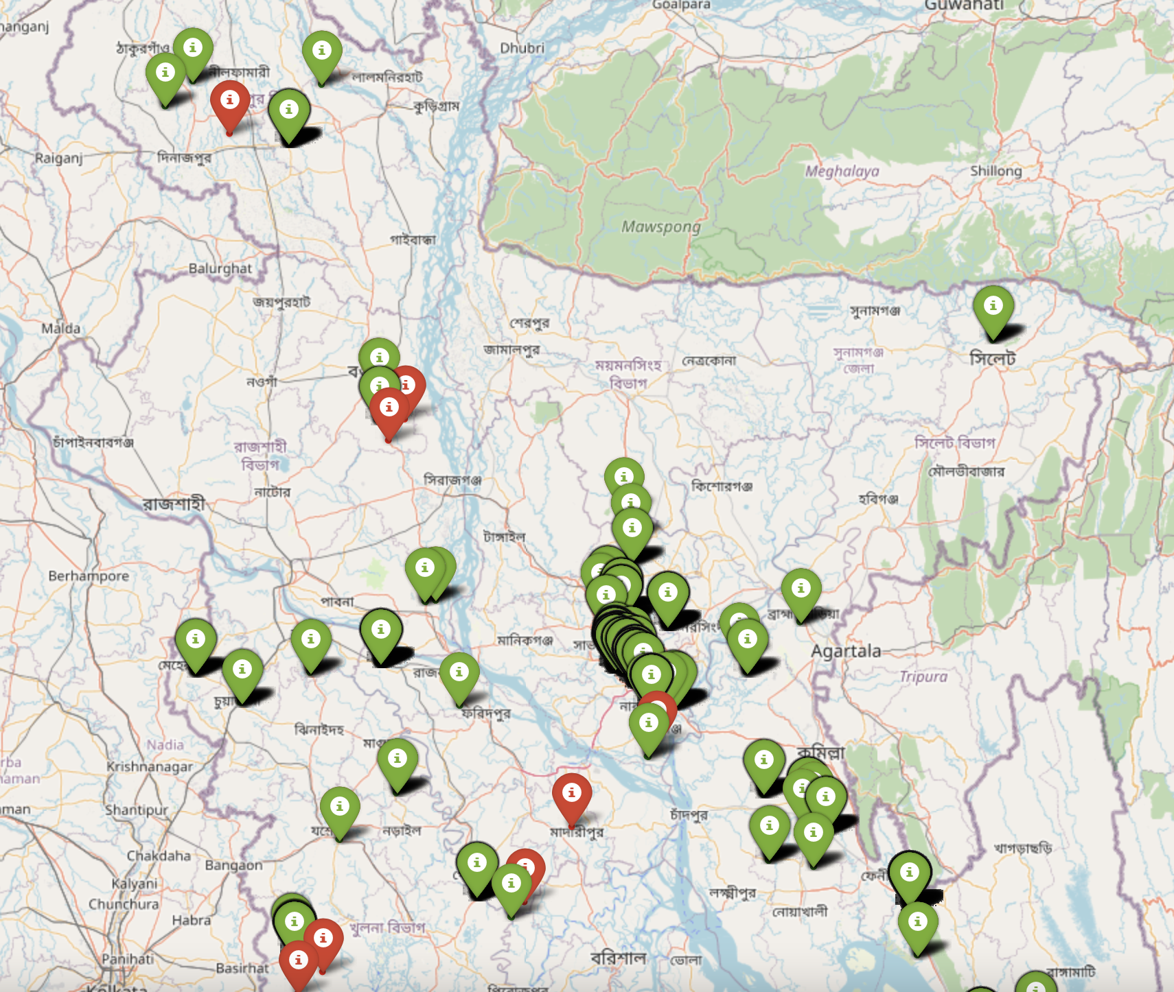
AGENT

Slide 12
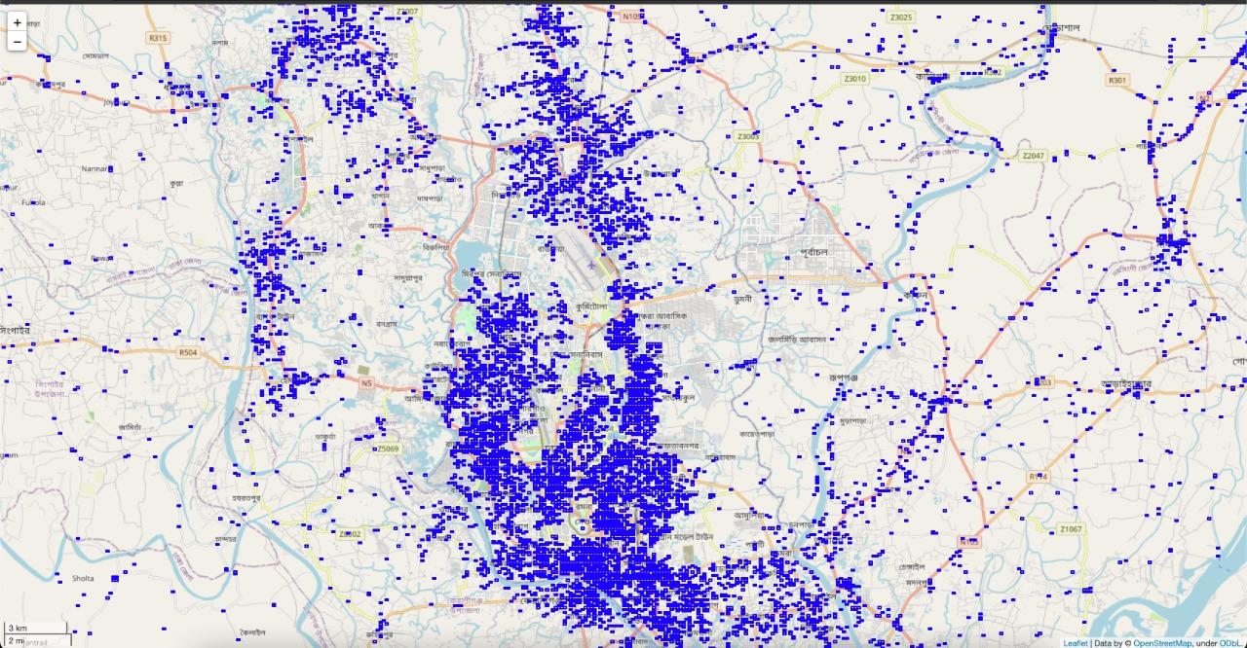
AGENT
There are 54099 geo-blocks with 89610 retail.

Slide 13
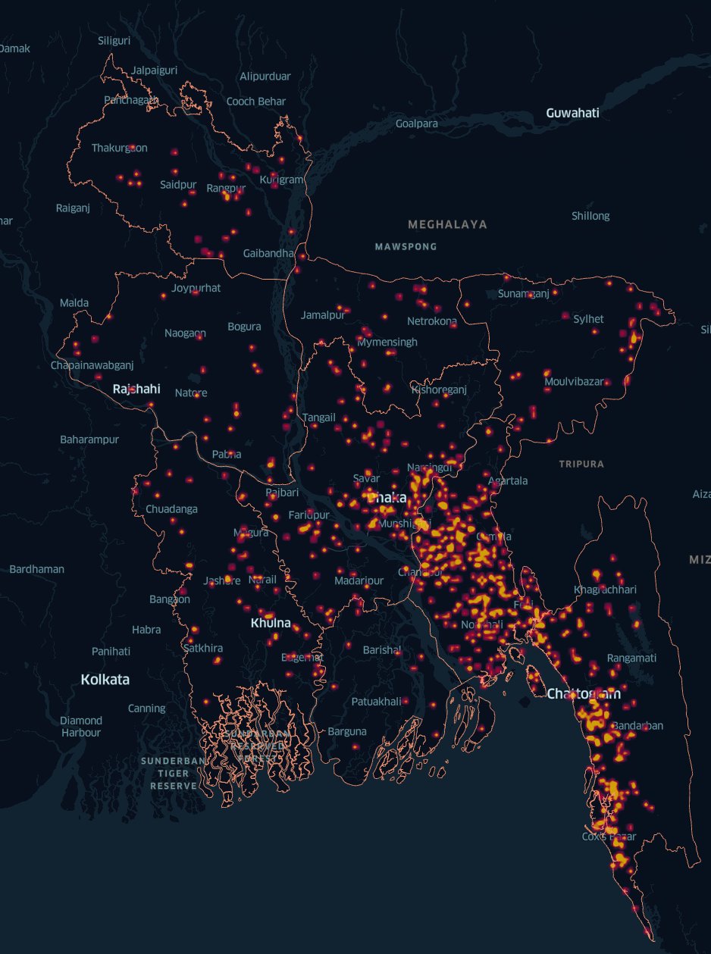
AGENT
For the next 10 retailer deployment, the zones having good sales but low agents should be considered.

Slide 14
FORECASTING
Next Week’s Daily Total Sale
Training dataset: DOD total sale.
The seasonal decomposition shows a multiplicative nature.
Has trend component, seasonality component.
The model trained is an ARIMA(0, 1, 0) with a constant.

Slide 15
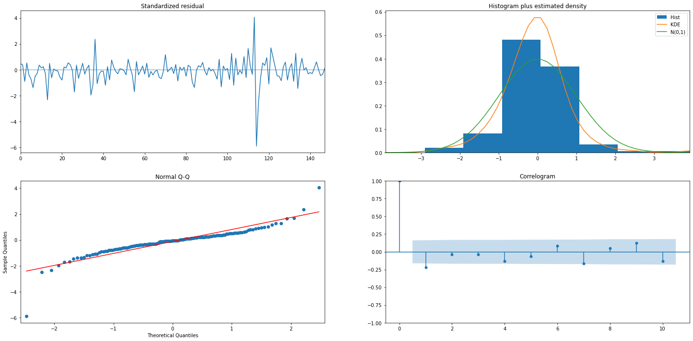
ARIMA

Slide 16
FORECASTING
Forecasting Next Day's Sales for Each Retail
Fitting an individual model for each of the retails is not a scalable solution.
One single time series model won’t be able to generalize well.
we thought of attacking the problem by looking at the data in a tabular form.

Slide 17
FORECASTING
Features
Day of Week - 0,1,2,3,4,5,6,7
No of Neighbor Retails - Retail points within 500m radius.
Distinct Products - Distinct products/services the retailer has.
Distinct Product Value - Monetary value of distinct products.
Previous 5 Weekdays Sales - E.g., for predicting this Tuesday's sales for a retailer we consider previous 5 Tuesday's data.
District

Slide 18
FORECASTING
Modelling & Evaluation
Initially, we used rolling average of the previous 5 weekdays sales values to establish a baseline of the model's accuracy. We got an MAE of ~230.
With the newly engineered featured, feature preprocessing, a hypertuned XGBoost regressor trained on 80% of the training set, we obtained an MAE of around ~110.

Slide 19
Seasonality
During winter season the peak hour is between 6PM and 7PM.
During summer the peak hour shifts to 7PM upto 8PM
During the month of Ramadan we can notice a sharp decline in transactions during Iftar hour 6PM to 6:59PM.
Lockdown and Covid restrictions can impact the volume of transactions negatively.
The total number of transactions fell during Ramadan has stayed the same until now, this could be due to inflation.
New product for price sensitive users.

Slide 20
Billboarding
Top 2 most popular products are Product 16 and Product 17 with ~8.8 million and ~8.6 million transactions respectively
Product 16 has high density in Dhaka and Chittagong.
Product 17 is more spread out across the country.

Slide 21
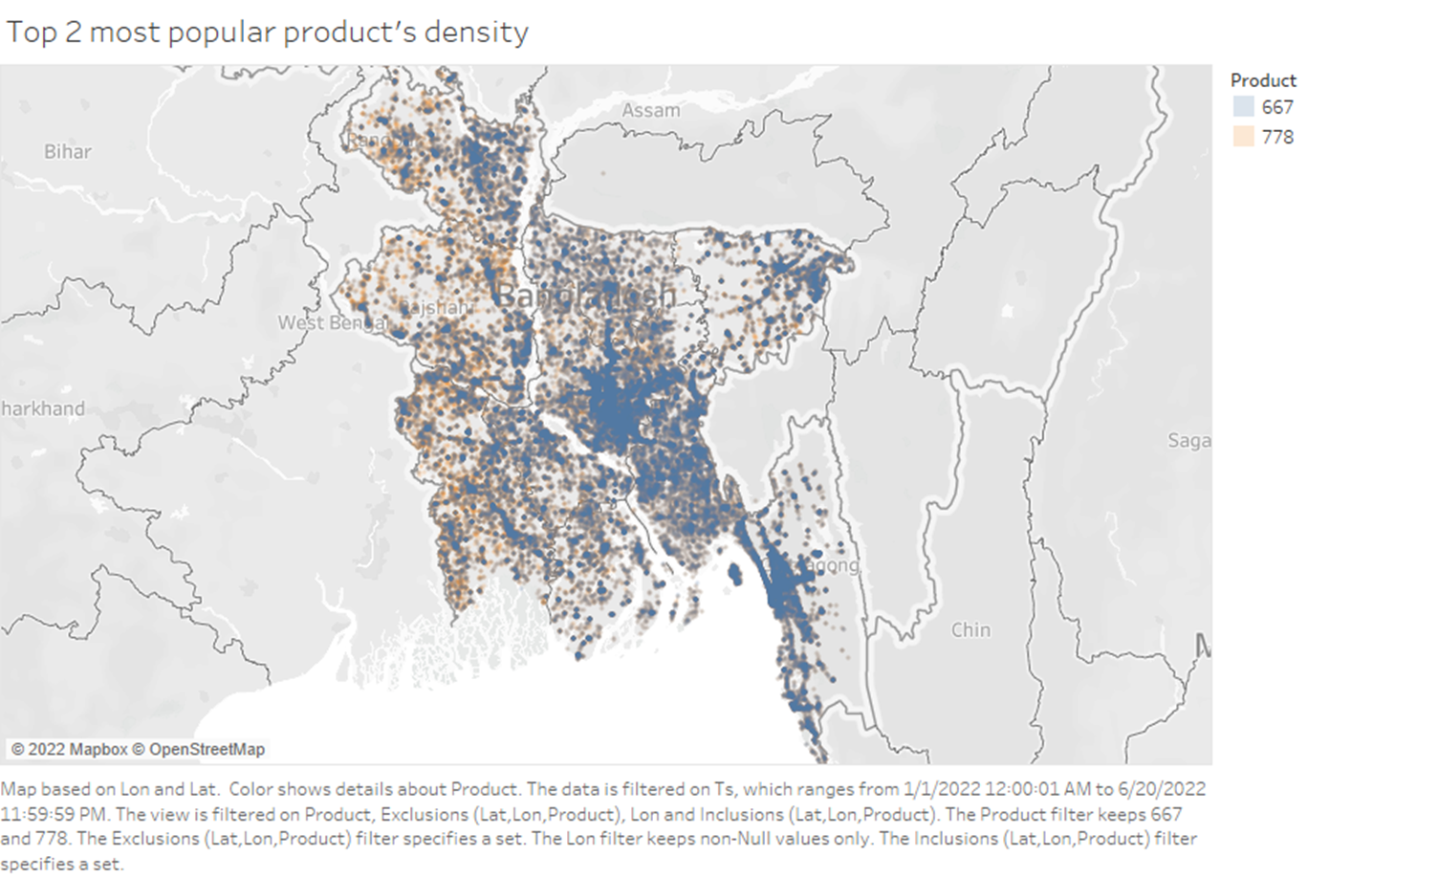
Billboarding
Legend:
Product 16
Product 17

Slide 22
Billboarding
Product 16 is probably send cash or digital payment feature, hence its more prevalent in developed cities with more outflow of cash or high digitization.
Product 17 might be a cash out feature.
However product 16 is market saturated in Dhaka and Chittagong but has a low entry barrier (Price 19 Taka)
We can use product 16 in billboards where cities can be more Dhaka like. Hence we propose Khulna which has the 3rd highest economy.

Slide 23
THANK YOU
All our supplementary resources are available here

